Slide 1
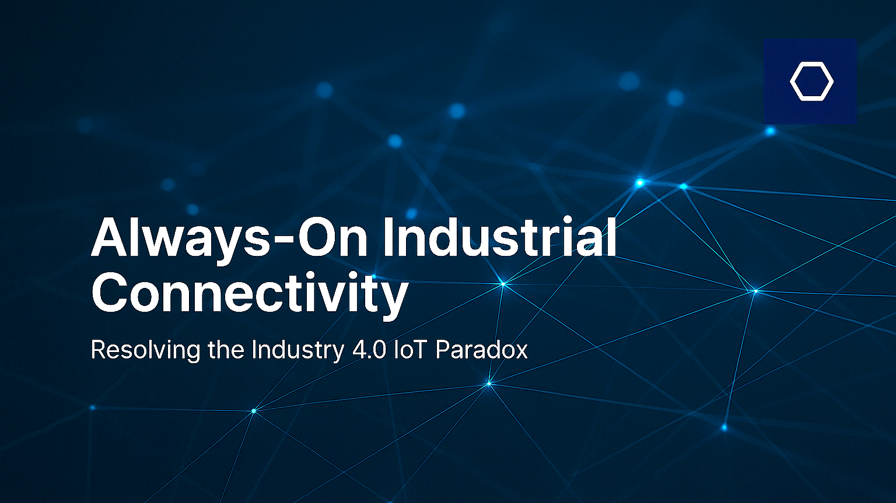

Always-On Industrial Connectivity
Resolving the Industry 4.0 IoT Paradox
[PLACEHOLDER: Cover Visual]

Slide 2
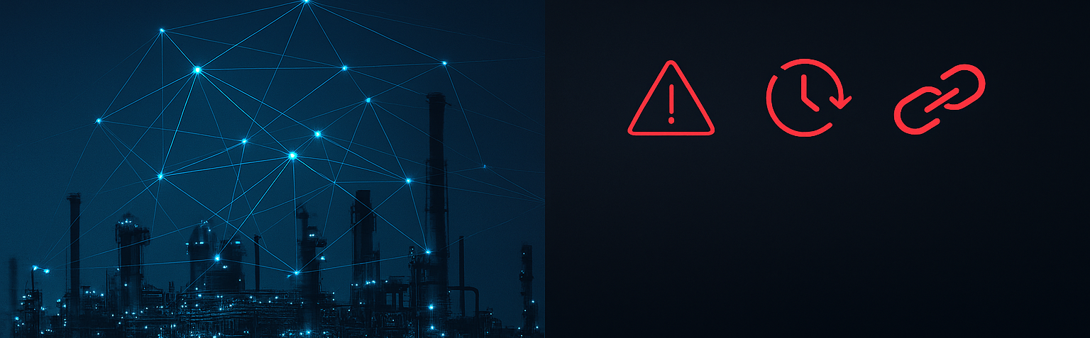
Industry 4.0
Promised Autonomy
The Problem
Connectivity never delivered
Single points of failure
Cloud & internet dependence
Fragile hub-based architectures
Mission‑critical systems go offline
Enterprises are actively searching for alternatives

Slide 3
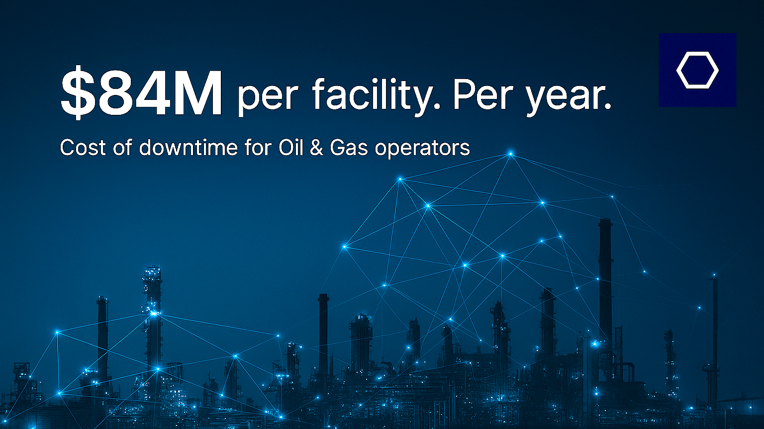
$84M per facility. Per year.
Cost of downtime for Oil & Gas operators
Directly related to connectivity failures*
[PLACEHOLDER: Money Slide Visual]
* Https://assets.new.siemens.com/siemens/assets/api/uuid:3d606495-dbe0-43e4-80b1-d04e27ada920/dics-b10153-00-7600truecostofdowntime2022-144.pdf

Slide 4

Our Solution -
Always-On. No Single Point of Failure.
Our platform, built on a new, open wireless mesh standard
Software & firmware for distributed wireless networks
Operating at the edge, optimizing bandwidth & reliability
100% uptime architecture, self-routing, self-healing
Vendor-agnostic by design, no proprietary hardware issues

Slide 5



How it works - Traditional IoT vs. Distributed Mesh Networks
GATEWAY TO ERP, BI, CLOUD, API, ETC.
Additional nodes degrade performance
Additional nodes improve performance/reach
Hub - single point of failure and cyber target
Self-routing/self-healing means 100% uptime

Slide 6
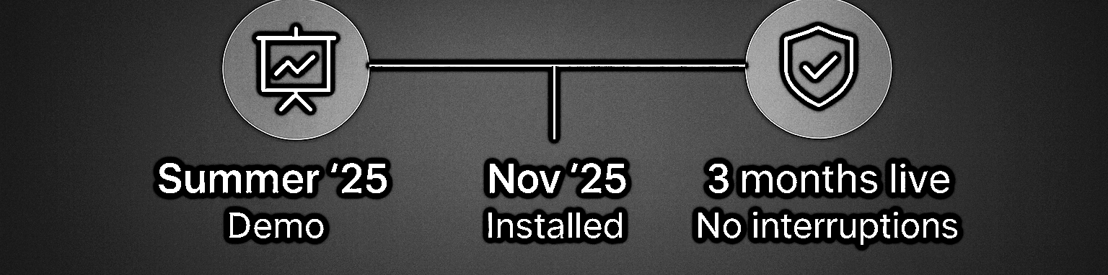
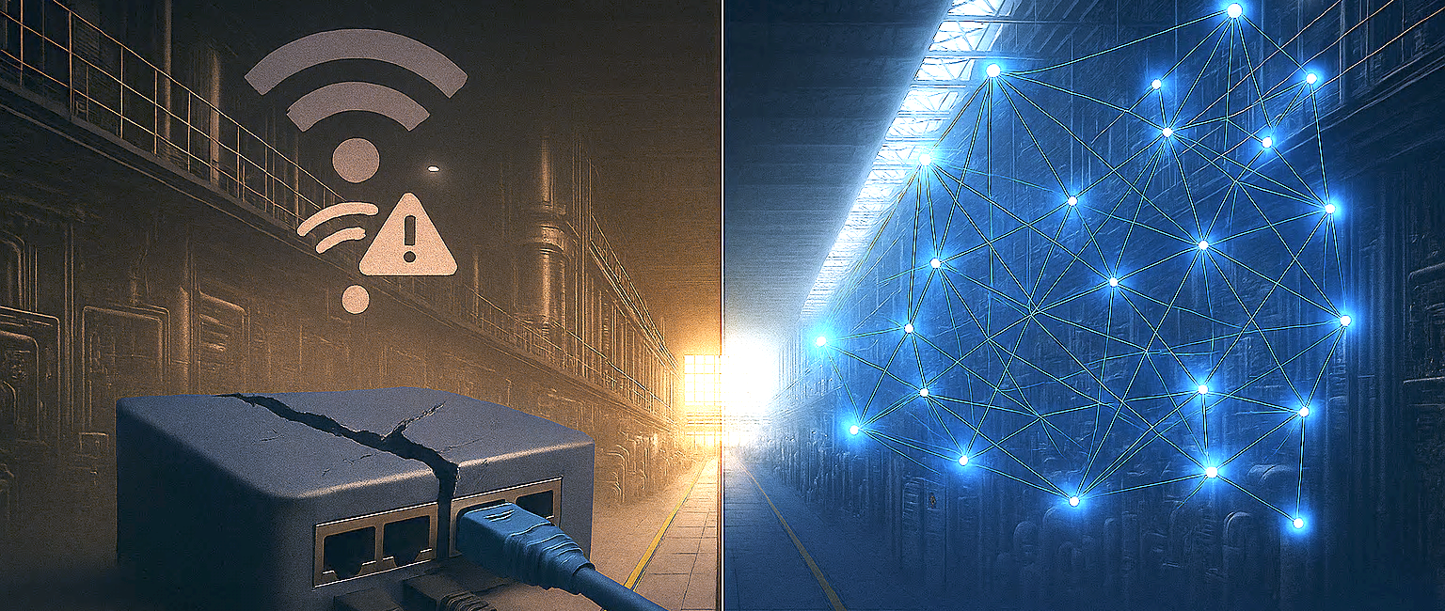
Traditional IoT vs. Distributed Mesh
Chevron’s challenges led to a POC
  Hub = failure + cyber target
  Single point of failure
  More nodes → worse performance
  “LoRa does not work in my refinery”
Chevron: Zero Failures in Live Operation
  Autonomous, resilient network
  No central hub
  More nodes → better performance
Proof: Chevron Use Case
Mission-critical sensor connectivity
Distributed mesh = always-on
Next Steps: Field trials → scale | Catalyst / CVC participation | Syndication across peers

Slide 7

The Platform
Foundational Network Infrastructure – software first
Distributed Wireless Networks
Edge-based SaaS + network intelligence = our IP
Operates on open, industrial grade Mesh standard
Deployable anywhere, any environment
Secure, low power, autonomous routing
Vendor-agnostic, kits & prototypes accelerate GTM
100% uptime for controls and data collection (AI)
Data to API
device firmware and prototypes
proprietary edge-based software
robust, open distributed standard

Slide 8











Scaling
market validation
active
paid pilots
same foundational, network infrastructure

Slide 9

Key Areas Monitored
Engine Room
HVAC
Galley
Water/Waste
Safety/Fire
Guest Cabins
Cargo

Slide 10
Key Areas Monitored
Engine Room
HVAC
Galley
Water/Waste
Safety/Fire
Guest Cabins
Cargo
Klaus V. – LIS, “I know exactly how the ship is functioning, freezer temperatures, and other conditions…until the guests arrive”

Slide 11
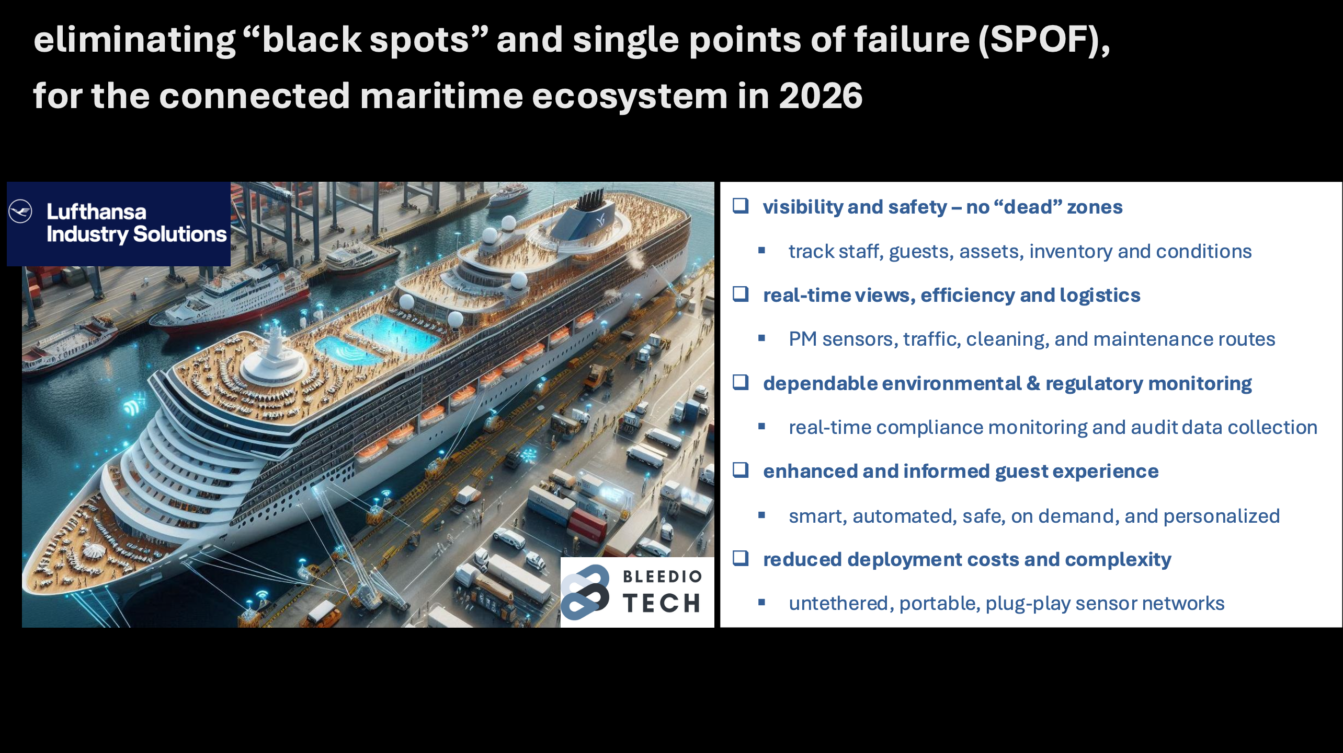

Slide 12






“ALWAYS ON”, DISTRIBUTED MESH NETWORKS, SOLVING OLD PROBLEMS AND CREATING NEW USE CASES
AVIATION - MRO
PUBLIC UTLIITIES
EXPO & EVENTS
inventory and logistics
remote energy telemetry
event insights & management
OIL & GAS
SMART CITIES
FARMS & RANCH
reliable sensor connectivity
environmental monitoring
conditions & livestock location

Slide 13

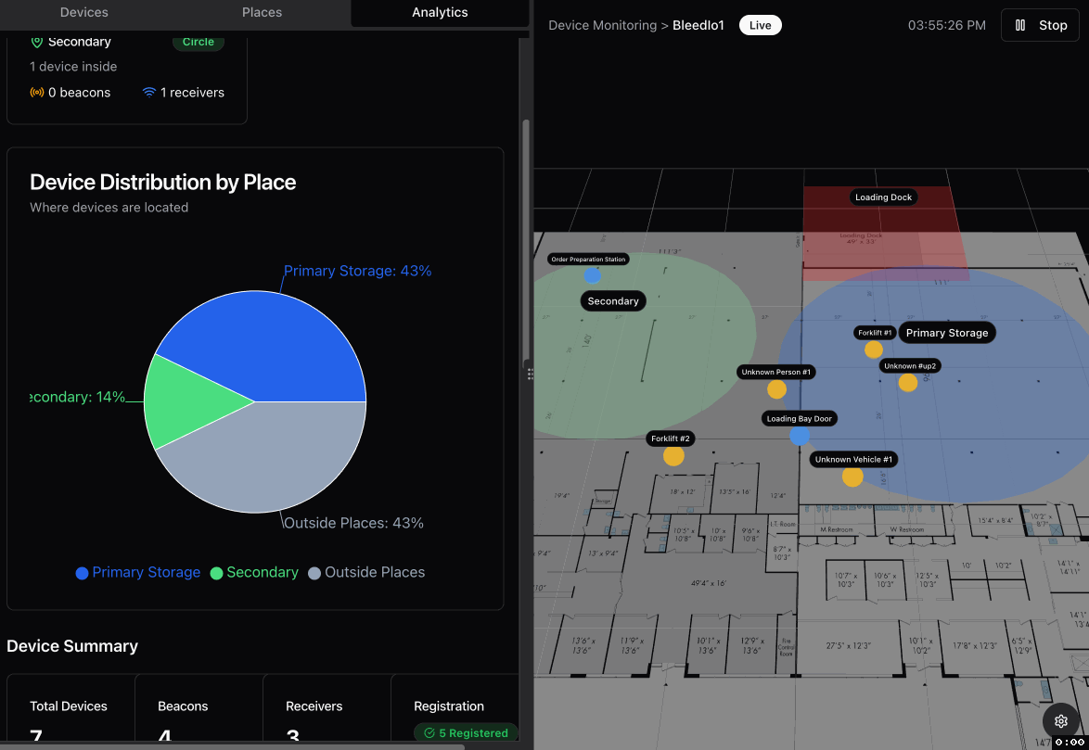
FIRE, EMS, POLICE
portable personnel tracking
Case summary
Teams have zero visibility of individuals’ locations when on the rescue scene.
Meshed beacon location resolution is sub 1M, leaders now able to identify individuals'’ locations on X,Y, and X axis.
Sensors attached to location beacon include air quality, temperature accelerometer, etc. to manage staff safety and observe conditions.

Slide 14

Business Model
SaaS-First, Data, Firmware licensing
Monthly subscription of $3 to $5 per networked device, multi-year contracts
Each network install will be worth $25K to $60K, plus multiple installs per site
Saas scales independently of hardware sources
Data, APIs, firmware licensing = upside

Slide 15


Grow enterprises directly
Drive adoption/retention in beachhead multi-nationals, leverage direct management and Infrastructure‑level stickiness
Scale with channels
Solving widespread, stubborn problems, with recurring revenue and plug-and-play deployment, effortless “upkeep” (4 active partners, 100+ wait list)
2Q 26 | 3Q 26 | 2027 | 2028
Secure seed funding Launch full “edge” version Onboard Advisors | Hire sales and implementation team Onboard software engineers Sell and develop with customer input | Execute direct & sales channel strategies Breakeven in 2027, complete Series A | SCALE

Slide 16
From Oil & Gas to Global Infrastructure
US industrials spend $150B per year on smart wireless initiatives, and expect connectivity
manufacturing, warehousing, logistics representing 1.3M+ locations, $48B IoT spend and urgent connectivity needs
at $48B+ aggregate IoT spend (25% on Bluetooth) its adopters with big problems, looking for solutions
first mover, category creator, we want 30% of our SAM
forecasted average installation is $25k to $60K per year
TAM - $48B
SAM - $12B
SOM – $4B
market size

Slide 17
Network Design Options – Competition or Collaboration?
Wireless Tech Considerations | locMESH™ netMESH™ by BleedIO | Wi-Fi | LoRa | 5G Networks | Centralized network’s challenges explained
Network Design | Decentralized BLE Mesh | Centralized | Centralized | Centralized | Central hubs are single points of failure
Resilient | YES – mesh is self healing/self routing | NO | NO | NO | Nodes require constant hub connectivity to function
Interoperable | YES – BleedIO is product agnostic | NO | NO | NO | Integrating disparate makes not possible
Data Collection | YES – mesh collects data with no interruption | NO | NO | NO | Inconsistent connectivity compromises data capture
Scalable | YES – improves as nodes are added | NO | NO | NO | Additional nodes slow network speeds
Responsive | YES – device to device(S) connect directly | SLOW | SLOW | SLOW | Hubs are “dispatchers” creating latency
Implementation | EASY - plug-and-play, auto-set up | HIGH | HIGH | HIGH | Complexity, low interoperability and expertise
Secure | YES – AES 256 military grade secure | POOR | POOR | POOR | AES 256 – military grade
Streaming capability | NONE | AVAILABLE | AVAILABLE | AVAILABLE | AVAILABLE – subject to “normal” interruptions and access issues

Slide 18


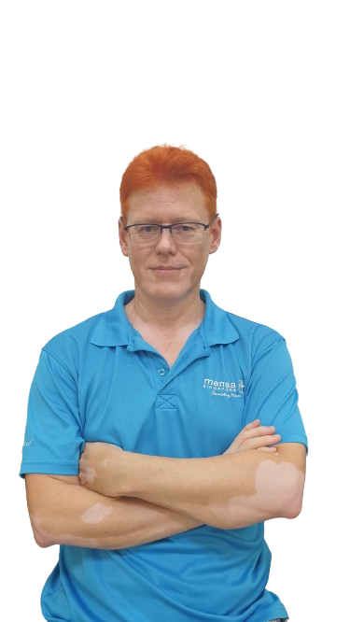

All Full Time, Execution-Focused, Capital-Efficient Team
BLE Mesh is an open standard — BleedIO is agnostic by design IP/Patent ownership, and prototyping support effective GTM motions
Stan Podolski, CEO/Cofounder
IP owner, Masters in Radio Physics, industry thought leader, 25 years EY, IBM, Accenture, leading IoT projects, start-up leader with a successful exit.
Leonardo Beup, CMO/Cofounder
30+ years leading marketing growth strategy for Fortune 500 industrials (Airgas, Air Liquide) turn arounds, and start-ups with a successful exit.
Mike Koloboff, Hardware manufacturing & rapid prototyping partner
Participated in pre-seed round. Enables zero-CapEx hardware strategy. Supports GTM kits and customer-specific prototypes
Brad Niems, CRO/Cofounder
recognized expertise in the networking space, 30+ years leading large scale IoT programs with Amphenol, and the owner of several patents and awards.

Slide 19

Financials
launch’26, breakeven ’27, scale by ‘28
 | 2026 | 2027 | 2028 | 2029
REVENUE | $280,000 | $2,100,000 | $14,400,000 | $39,240,000
INSTALLS | 7 | 35 | 240 | 654
$GM | $192,500 | $1,662,500 | $12,000,000 | $32,700,000
TOTAL EXP | $900,000 | $1,600,000 | $10,200,000 | $21,000,000
EBITDA | ($707,500) | $62,500 | $1,800,000 | $11,700,000
EBITDA % | -252.68% | 2.98% | 12.50% | 29.82%
FTES | ‘26 | ‘27 | ‘28-’29
SALES | 3 | 5 | 45
ENGINEERING | 3 | 3 | 25
G&A | 1.5 | 3 | 5
Key assumptions
installation value grows to $60k per
CAC drops by 25% in 2028
sales includes implementation FTEs
retention will be better than 95%
series A integrated in 2nd half of 2027
4X increase SALES & ENG FTEs in 2028

Slide 20
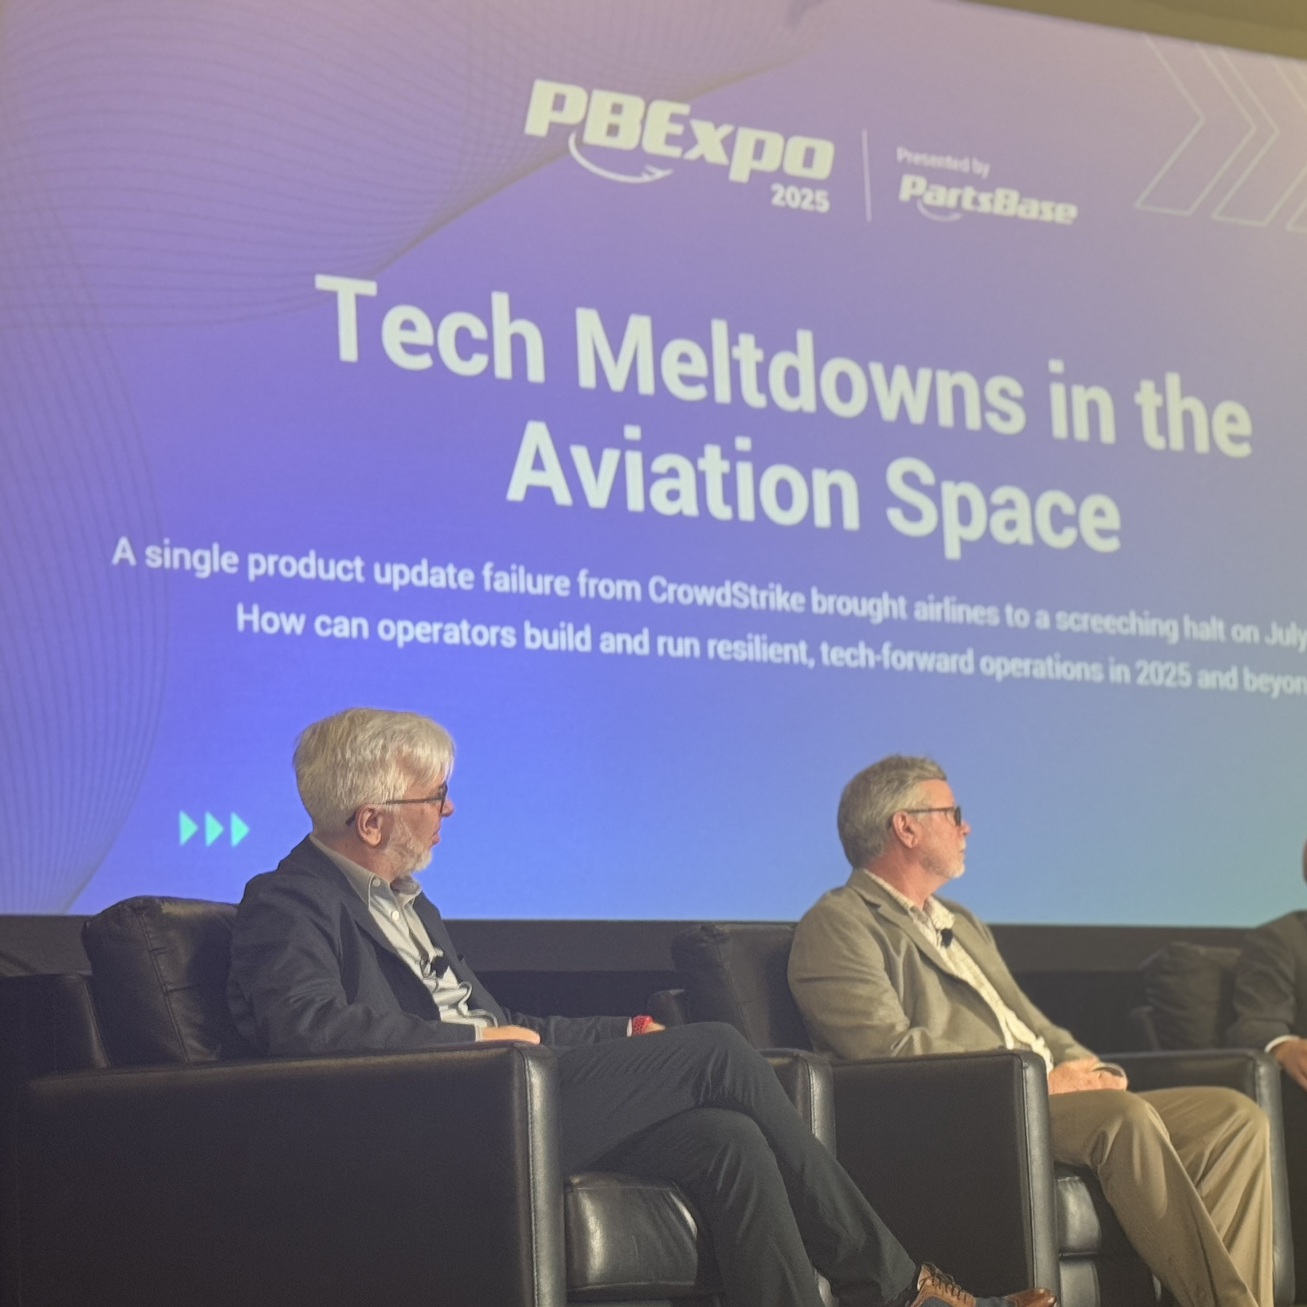
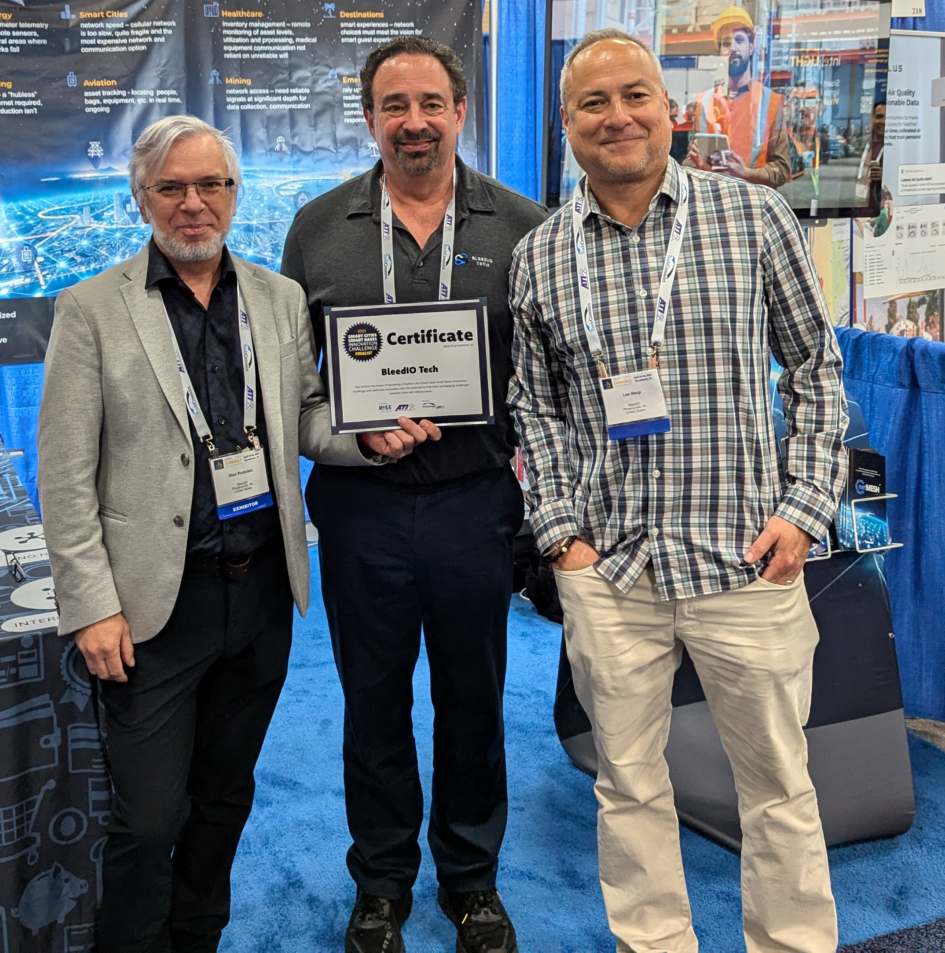
Recognized and Rewarded
Phorum 2026 – Winner
Winner of Lion Cage Tech Category
CDL Alumni 2025-26
NVIDIA Inception program acceptance
2X BIND Finalist
Accepted into Founders Institute
Accepted into Microsoft, CUNY & Batchery, accelerators
PACT Tech-Startup of the Year Finalist
AVF Philadelphia Finalist
Featured presenters for ATI, PBEXPO, TechConnect
TechConnect’s Smart City Innovation finalist
Finalist TechConnect World Innovation
Awarded MOSA Innovation Finalist

Slide 21
Ask
We are raising a $900K seed, to serve new/existing enterprise customers and accelerate software, firmware and prototype development
Use of funds (‘26 – ’27)
$300K engineering
$300K sales
$300k G&A
Key outcomes
launch V2, secure beachhead manufacturing, warehouse customers, and $2 million in ARR
What’s next
leverage success to target other large IoT segments, like shipping, or healthcare
BleedIO’s seed round will get us to break even, positioned for growth capital
Our exit objective - acquired within 8 years, potential buyers cross industries

Slide 22

The Networks Upon Which Industries Depend
BleedIO is building a foundational connectivity layer for the physical world,
one that operates independently of hubs, clouds, or centralized infrastructure.
Industry 4.0’s vision is unfulfilled, leaving customers with expensive problems
New, complimentary mesh architecture is distributed, autonomous, and always on
Team of experienced operators, solving long term customer issues
Built on open standards for long-term interoperability, networks designed to scale
Becomes stronger, more resilient, and more valuable as it grows
www.bleedio.com connect@bleedio.com www.linkedin.com/company/bleedio

